Slide 1
Deep Learning Framework

Slide 2










Slide 3
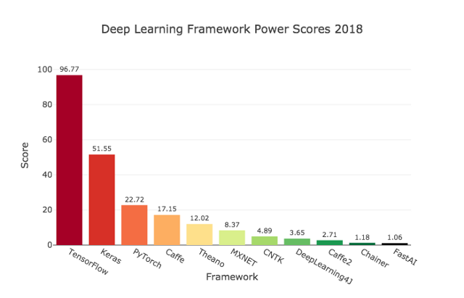
https://towardsdatascience.com/deep-learning-framework-power-scores-2018-23607ddf297a
Notes:
The evaluation categories are:
Online Job Listings
KDnuggets Usage Survey
Google Search Volume
Medium Articles
Amazon Books
ArXiv Articles
GitHub Activity

Slide 4
Important Libraries
jupyter
numpy
scikit-learn
matplotlib
tensorflow
keras

Slide 5
Some Important Libraries : Installation
pip install jupyter
pip install numpy
pip install scikit-learn
pip install matplotlib
pip install tensorflow
pip install keras
Notes:
Jupyter allows you to edit and run your python code in your browser, organise the documentation along with the code and it also makes it really easy to create some material that can be presented.
Numpy
Numpy is a python library for scientific computing. It is more than necessary for any work on machine learning or data science.
Scikit-learn
Scikit-learn is a tool for data mining and data analysis. It can really help a lot
Matplotlib
Plotting data is crucial whether you wanna have a first insight upon the task you're working on or when you need to show an analysis to someone. Matplotlib is the tool for the job.

Slide 6
Tensorflow
Open sourced in November 2015 by Google Brain Team

Slide 7

Companies Using Tensorflow

Slide 8
What is Tensor ?
An n-dimensional array
0-d is a scalar
1-d is a vector
2-d is a matrix

Slide 9
Tensor Examples
# a rank 0 tensor; a scalar with shape [],
# a rank 1 tensor; a vector with shape [3]
[1., 2., 3.]
# a rank 2 tensor; a matrix with shape [2, 3]
[[1., 2., 3.], [4., 5., 6.]]

Slide 10
Graphs Computation
Basic Code Structure - Graphs
● Nodes are operators (ops), variables, and constants
● Edges are tensors
0-d is a scalar
1-d is a vector
2-d is a matrix
TensorFlow = Tensor + Flow = Data + Flow

Slide 11
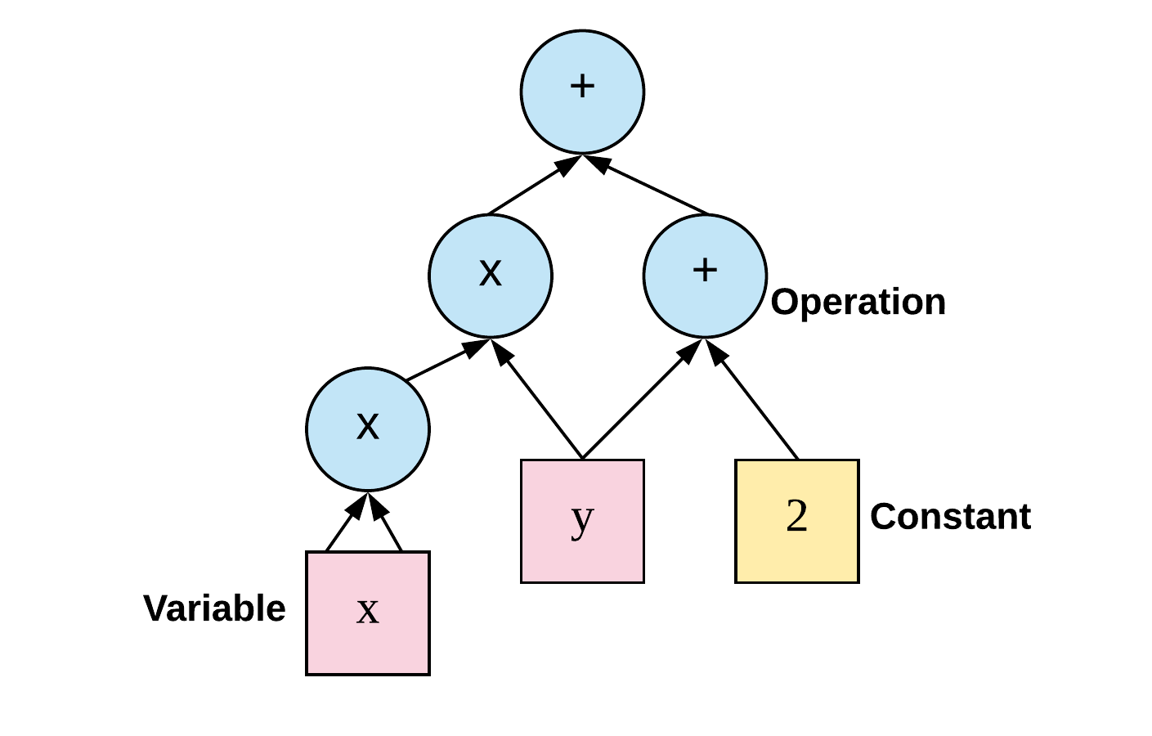
Flow Graphs

Slide 12
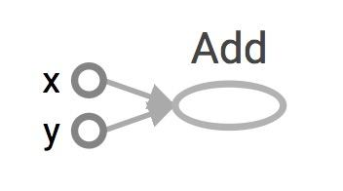
Data Flow Graphs
import tensorflow as tf a = tf.add(3,5)
What is value of a, after running this code?
Notes:
Notice that printing the tensors does not output the values 8 as you might expect. The above statements only build the computation graph

Slide 13
Session
To evaluate tensors
tf.Session
Its like python executable.

Slide 14
Session
Step 1 : Create a tf.Session object
sess = tf.Session()
Step 2: Use run method to evaluate
print(sess.run())

Slide 15
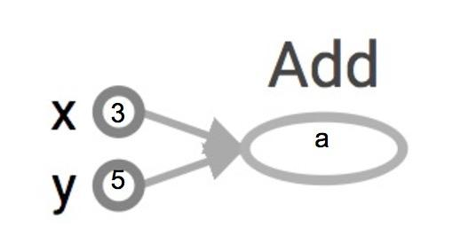
import tensorflow as tf a = tf.add(3, 5)
How to get the value of a?
sess = tf.Session() print(sess.run(a)) sess.close()

Slide 16
sess = tf.Session() print(sess.run(a)) sess.close()
# Other way to define Session.
with tf.Session() as sess: print(sess.run(a))

Slide 17
More Examples
x = 10 y = 12
o1 = tf.add(x, y) o2 = tf.multiply(x, y) o3 = tf.pow(o2, o1)
with tf.Session() as sess: o3 = sess.run(o3)
Notes:
tf.Session()
A Session object encapsulates the environment in which Operation objects are executed, and Tensor objects are evaluated.Session will also allocate memory to store the current values of variables.

Slide 18
Constant
a = tf.constant(5) b = tf.constant(7) x = tf.add(a, b)
with tf.Session() as sess: print(sess.run(x))

Slide 19
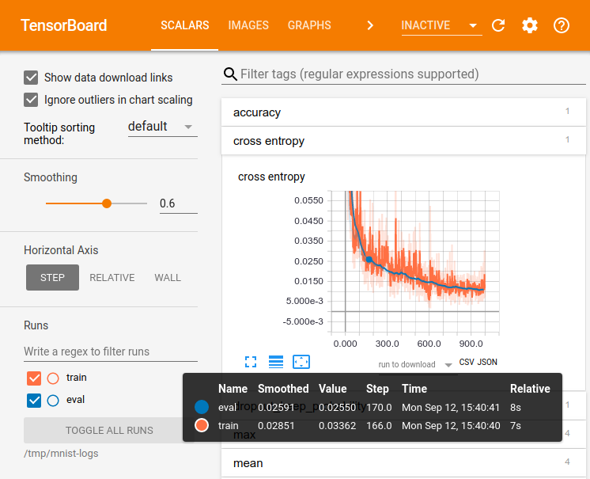
Tensor Board and Summary

Slide 20
How to Get TensorBoard:
a = tf.constant(7) b = tf.constant(8) x = tf.add(a, b)
writer = tf.summary.FileWriter('./graphs', tf.get_default_graph()) with tf.Session() as sess: print(sess.run(x)) writer.close() # close the writer when you’re done using it

Slide 21
How To See the Graph
Go to terminal, run:
$ tensorboard --logdir="./graphs" --port 6006
Then open your browser and go to: http://localhost:6006/

Slide 22
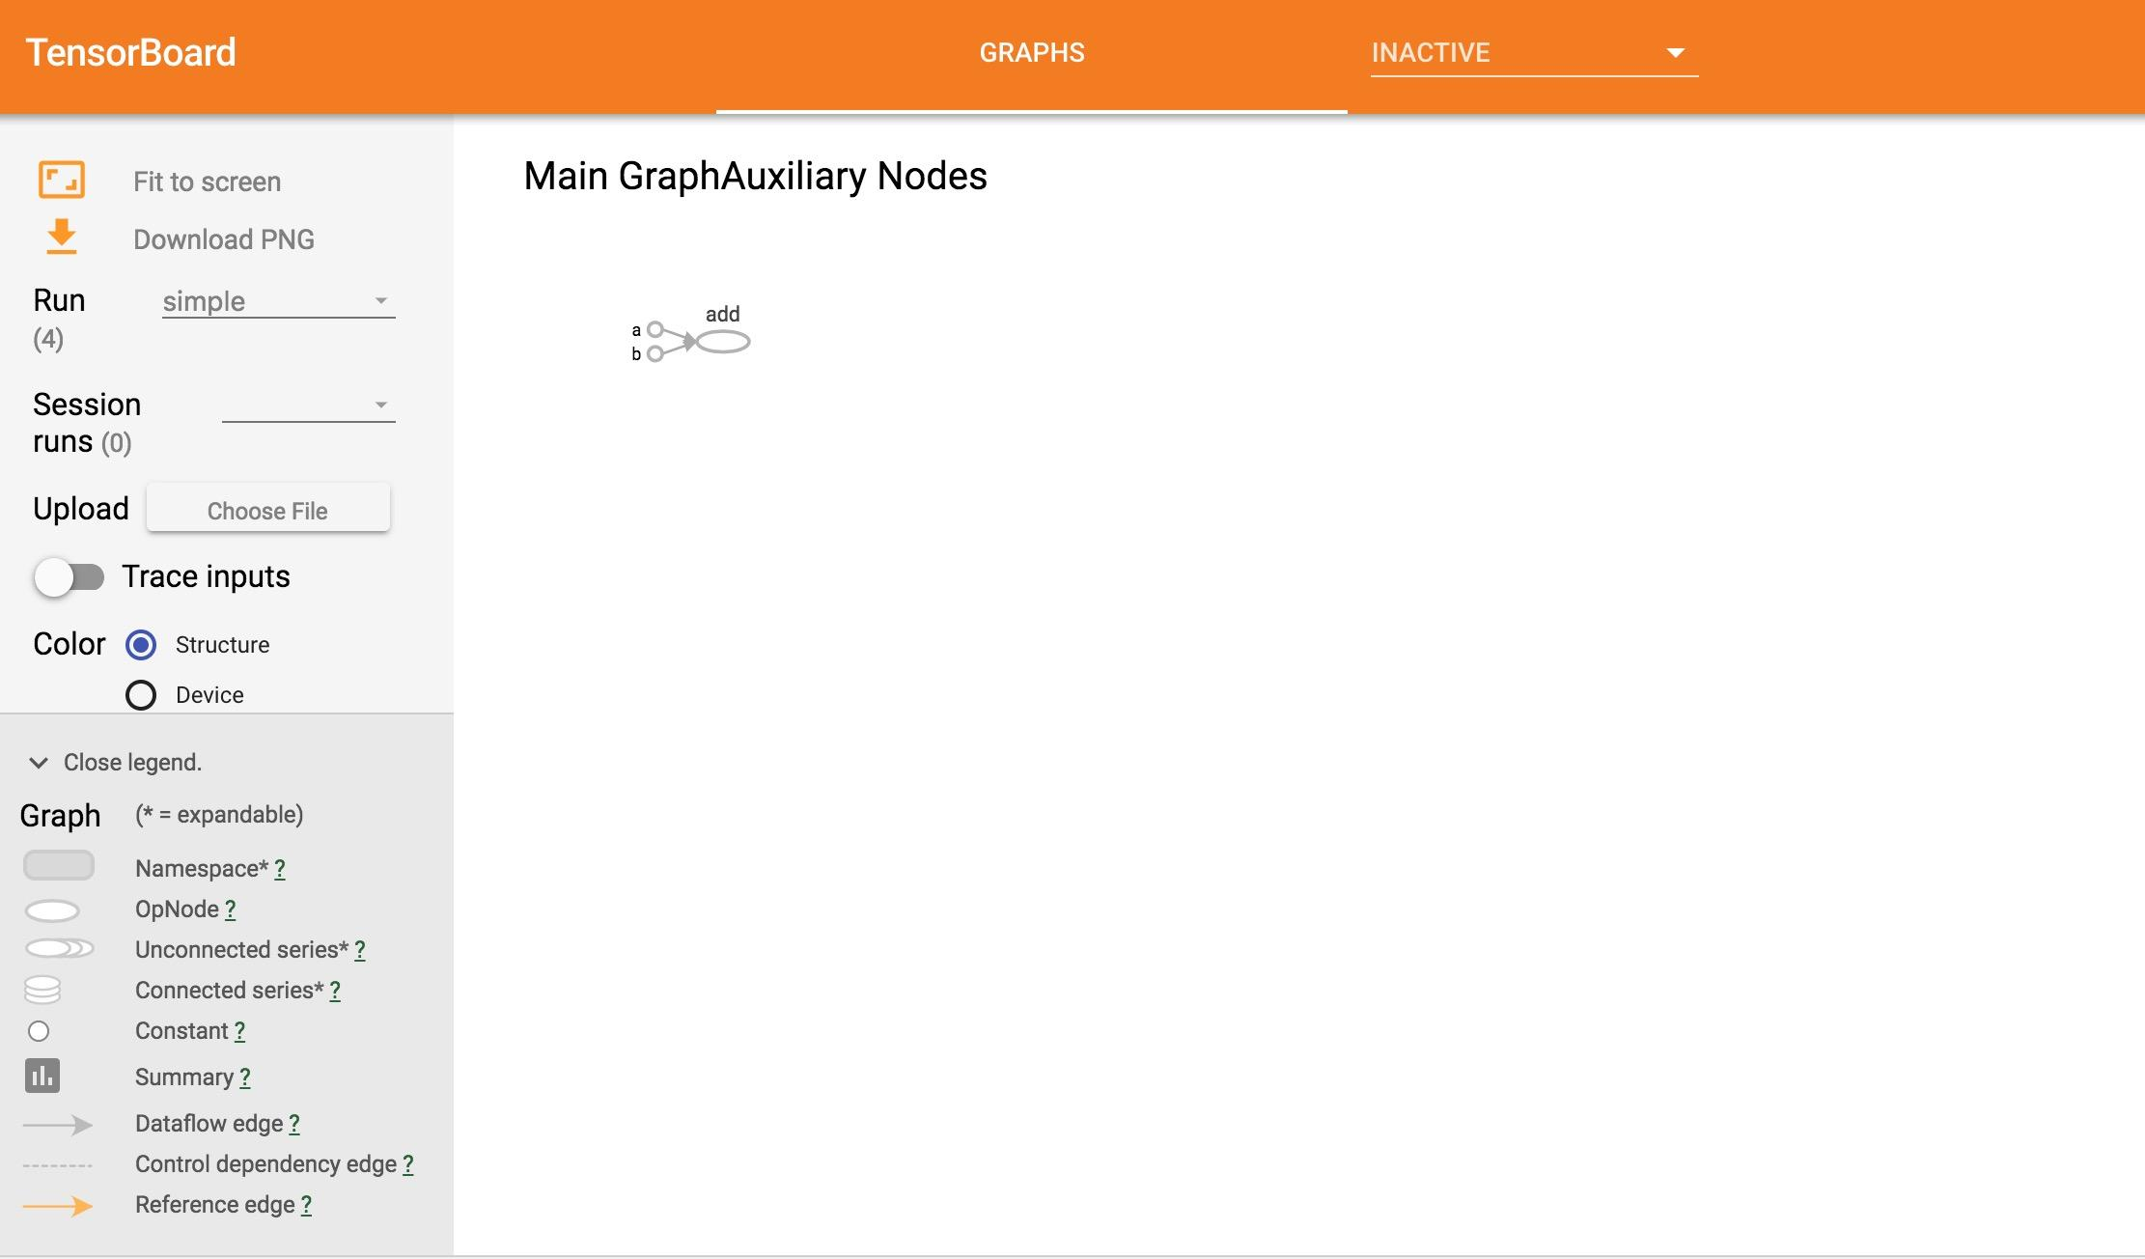

Slide 23
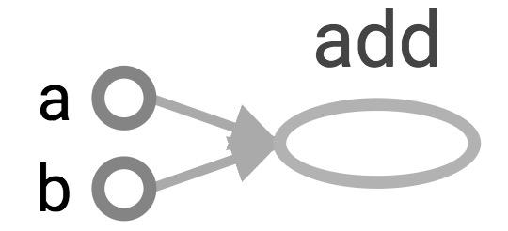
Adding custom name
a = tf.constant(2, name='a') b = tf.constant(3, name='b') x = tf.add(a, b, name='add')
writer = tf.summary.FileWriter('./graphs', tf.get_default_graph()) with tf.Session() as sess: print(sess.run(x))
writer.close()

Slide 24
Constant Summary:
tf.constant ( value,
dtype=None,
shape=None,
name='Const',
verify_shape=False)
a = tf.constant([4, 4], name='a') b = tf.constant([[0, 2], [5, 3]], name='b')
out = tf.multiply(a, b, name='multi')
with tf.Session() as sess: print(sess.run(out))

Slide 25
Some useful functions in tensorflow
tf.zeros(shape, dtype=tf.float32, name=None)
tf.zeros([2, 3], tf.int32)
[[0, 0, 0], [0, 0, 0]]

Slide 26
Some useful functions in tensorflow
tf.ones(shape, dtype=tf.float32, name=None)

Slide 27
Some useful functions in tensorflow
tf.lin_space(start, stop, num, name=None)
tf.lin_space(10.0, 13.0, 4)
[10. 11. 12. 13.]

Slide 28
Some useful functions in tensorflow
tf.range(start, limit=None, delta=1, type=None, name='range')
tf.range(3, 18, 3)
[3 6 9 12 15]
tf.range(5)
[0 1 2 3 4]

Slide 29
Some useful functions in tensorflow
tf.set_random_seed(seed)

Slide 30
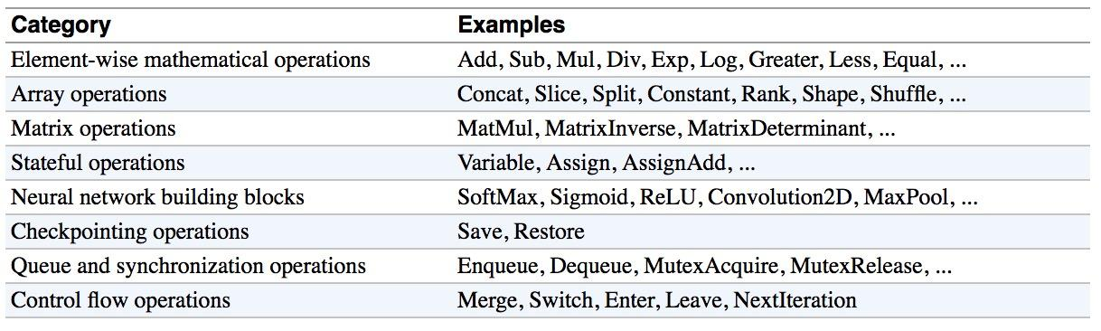
Other Functions

Slide 31
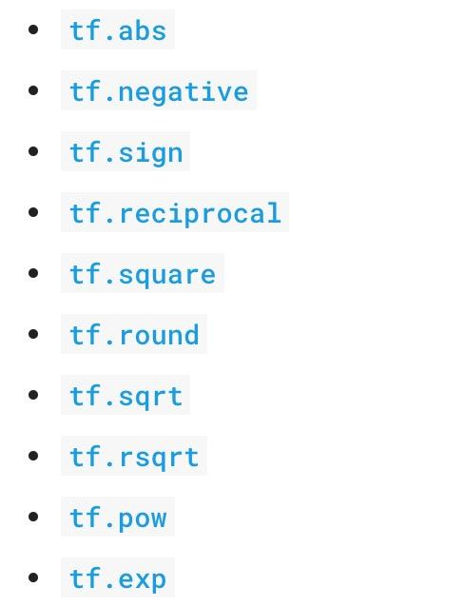
Other Functions : Mathematical Functions.

Slide 32
Functions : tf.matmul
Multiplies matrix a by matrix b, producing a * b.
Tf.matmul ( a, b,
transpose_a=False, transpose_b=False,
adjoint_a=False, adjoint_b=False,
a_is_sparse=False, b_is_sparse=False,
name=None )

Slide 33
Example
# 2-D tensor `a` [[1, 2, 3], [4, 5, 6]]
a = tf.constant([1, 2, 3, 4, 5, 6], shape=[2, 3])
# 2-D tensor `b` [[ 7, 8], [ 9, 10], [11, 12]]
# `a` * `b`
c = tf.matmul(a, b)
[[ 58, 64], [139, 154] ]
Notes:
b = tf.constant([7, 8, 9, 10, 11, 12], shape=[3, 2])

Slide 34
Tensorflow Vs Numpy
NumPy arrays: NumPy is not GPU compatible

Slide 35
Tensorflow Variable
# create variables with tf.Variable class
A tf.Variable represents a tensor whose value can be changed by running ops on it.
s = tf.Variable(2, name="scalar")
m = tf.Variable([[0, 1], [2, 3]], name="matrix")
W = tf.Variable(tf.zeros([784,10]))
Notes:
Why tf.constant but tf.Variable?
tf.constant is an op
tf.Variable is a class with many ops
tf.Variable holds several ops:
x = tf.Variable(...)
x.initializer # init op
x.value() # read op
x.assign(...) # write op
x.assign_add(...) # and more

Slide 36
Tensorflow Variable: Initializing variables
Before you can use a variable, it must be initialized.
To initialize all trainable variables in one go, before training starts, call tf.global_variables_initializer()
#The easiest way is initializing all variables at once:
with tf.Session() as sess:
sess.run(tf.global_variables_initializer())

Slide 37
Tensorflow Variable: Initializing variables
#Initialize only a subset of variables:
with tf.Session() as sess:
sess.run(tf.variables_initializer([a, b]))

Slide 38
Tensorflow Variable: Initializing variables
#Initialize a single variable
W = tf.Variable(tf.zeros([784,10]))
with tf.Session() as sess:
sess.run(W.initializer)

Slide 39
Example:
W is a random 700 x 100 variable object
W = tf.Variable(tf.truncated_normal([700, 100]))
with tf.Session() as sess:
sess.run(W.initializer)
print(W.eval())

Slide 40
Use of Multiple Sessions :
W = tf.Variable(10)
sess1 = tf.Session()
sess2 = tf.Session()
sess1.run(W.initializer)
sess2.run(W.initializer)
print(sess1.run(W.assign_add(10))) # 20
print(sess2.run(W.assign_sub(2))) # 8

Slide 41
Placeholders
A TF program has two steps :
Assemble a graph and use a session to execute operations in the graph.
Assemble the graph first without knowing the values needed for computation

Slide 42
Example
Define the function f(x, y) = 2 * x + y without knowing value of x or y.
x, y are placeholders for the actual values.

Slide 43
Why placeholders?
We or any user or client , can later supply their own data when they need to execute the computation.

Slide 44
Syntax
tf.placeholder(dtype, shape=None, name=None)
create a placeholder for a vector of 3 elements, type tf.float32
a = tf.placeholder(tf.float32, shape=[3])
b = tf.constant([5, 5, 5], tf.float32)
use the placeholder as you would a constant or a variable
c = tf.add(a, b)
with tf.Session() as sess:
print(sess.run(c))
???????

Slide 45
Feed_dict :
tf.placeholder(dtype, shape=None, name=None)
create a placeholder for a vector of 3 elements, type tf.float32
a = tf.placeholder(tf.float32, shape=[3])
b = tf.constant([5, 5, 5], tf.float32)
use the placeholder as you would a constant or a variable
c = tf.add(a, b)
with tf.Session() as sess:
print(sess.run(c, feed_dict={a: [1, 2, 3]}))
Notes:
# the tensor a is the key, not the string ‘a’
# >> [6, 7, 8]

Slide 46
Examples feed_dict
create operations, tensors, etc (using the default graph)
a = tf.add(2, 5)
b = tf.multiply(a, 3)
with tf.Session() as sess:
# compute the value of b given a is 15
sess.run(b, feed_dict={a: 15})

Slide 47
Take away : Important
● Constants are fixed value tensors - not trainable
● Variables are tensors initialized in a session - trainable
● Placeholders are tensors of values that are unknown during the graph construction, but passed as input during a session
Ops are functions on tensors

Slide 48
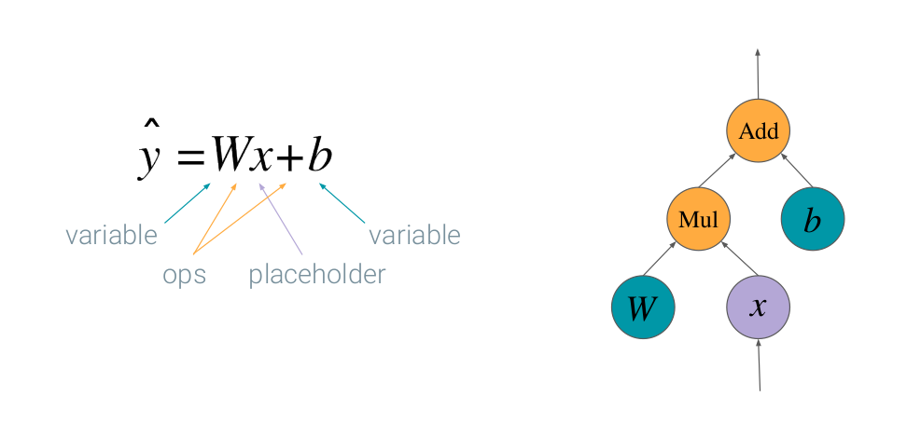
Deep Learning in Tensorflow

Slide 49
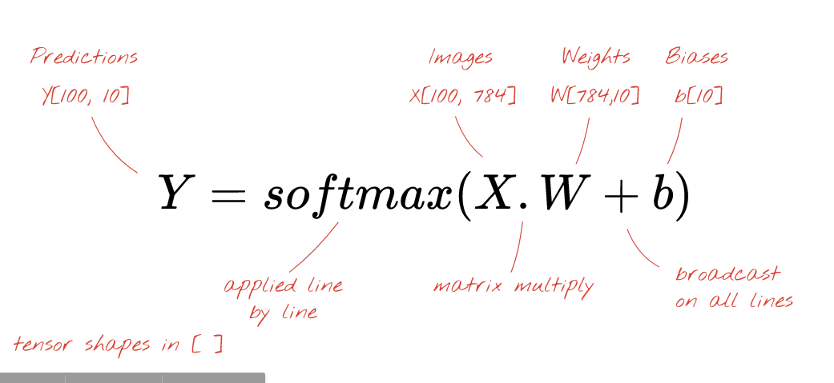
Taken From: https://codelabs.developers.google.com/codelabs/cloud-tensorflow-mnist/

Slide 50
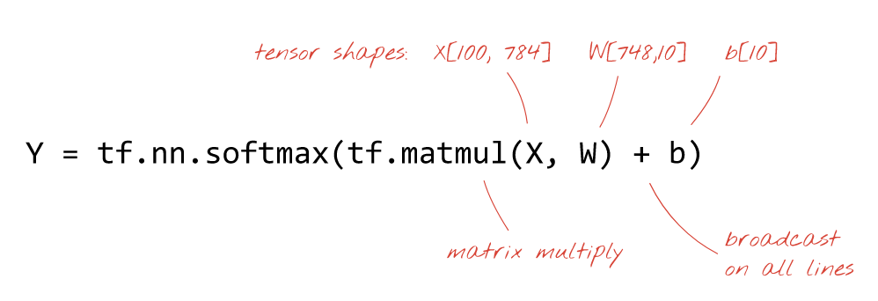

Slide 51
Example with Tensorflow
https://docs.google.com/presentation/d/1TVixw6ItiZ8igjp6U17tcgoFrLSaHWQmMOwjlgQY9co/pub#slide=id.g124df921bc_0_212

Slide 52
Keras
Keras is a API build on tensorflow to build and train deep learning models.
It's used for fast prototyping, advanced research
import tensorflow as tf
from tensorflow import keras

Slide 53
Sequential model
You build model by assembling layers
Model is a graph of layers
Stack of Layers in keras tf.keras.Sequential

Slide 54
Example
model = keras.Sequential()
# Adds a densely-connected layer with 64 units to the model:
model.add(keras.layers.Dense(64, activation='relu'))
# Add another:
model.add(keras.layers.Dense(64, activation='relu'))
# Add a softmax layer with 10 output units:
model.add(keras.layers.Dense(10, activation='softmax'))

Slide 55
Eager execution
You could execute TensorFlow operations directly from Python without graph compilation.
A NumPy-like library for numerical computation with support for GPU acceleration
Eager executions implifies your code
You no longer need to worry about
Placeholders
Sessions
control dependencies
{name, variable, op} scopes

Slide 56
import tensorflow
# version >= 1.50
import tensorflow.contrib.eager as tfe
tfe.enable_eager_execution()

Slide 57
Earlier
x = tf.placeholder(tf.float32, shape=[1, 1]) m = tf.matmul(x, x) print(m) # Tensor("MatMul:0", shape=(1, 1), dtype=float32) with tf.Session() as sess: m_out = sess.run(m, feed_dict={x: [[2.]]}) print(m_out)

Slide 58
Now
x = [[2.]] # No need for placeholders! m = tf.matmul(x, x) print(m) # No sessions!

Slide 59
Loss can be defined as
x = tfe.Variable(2.0)
def loss(y): return (y - x ** 2) ** 2 grad = tfe.implicit_gradients(loss)

Slide 60
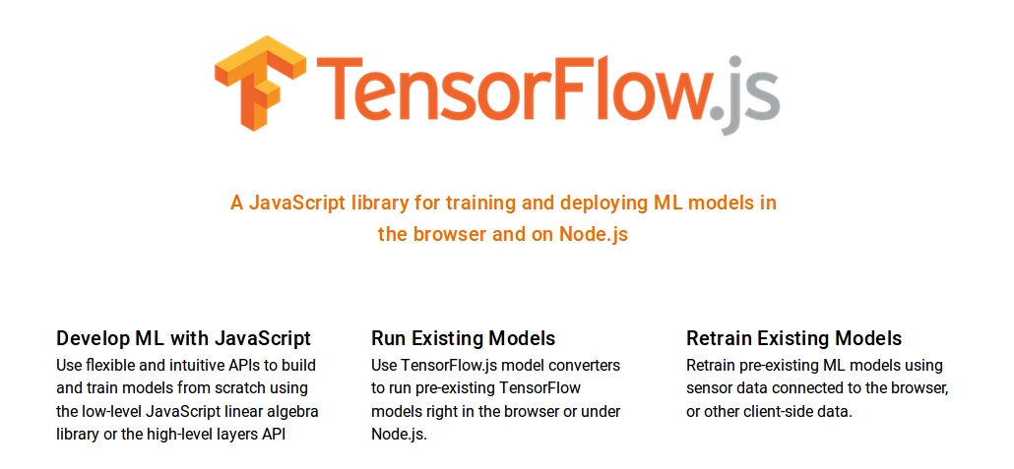
https://js.tensorflow.org/tutorials/

Slide 61

Tensorflow Lite : https://www.tensorflow.org/lite/

Slide 62
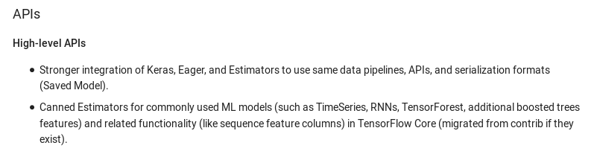
Tensorflow 2.0

Slide 63
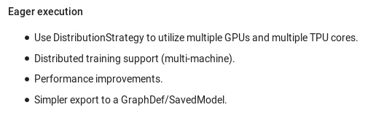

Slide 64
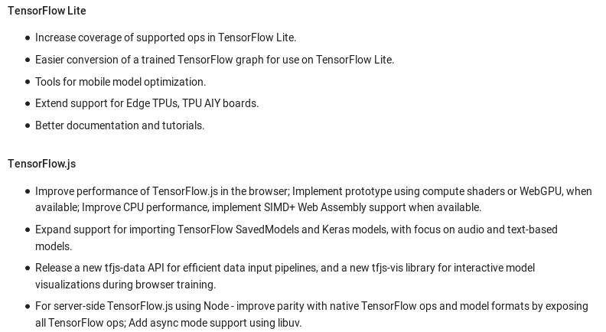

Slide 65
DNN in Keras: Step 1 : Import Tensorflow
import tensorflow as tf

Slide 66
Step 2 : Get dataset
import tensorflow as tf
mnist = tf.keras.datasets.mnist

Slide 67
Step 3 : Train and Test
import tensorflow as tf
mnist = tf.keras.datasets.mnist
(x_train, y_train),(x_test, y_test) = mnist.load_data()

Slide 68
Step 4 : Normalize your Input
import tensorflow as tf
mnist = tf.keras.datasets.mnist
(x_train, y_train),(x_test, y_test) = mnist.load_data()
x_train, x_test = x_train / 255.0, x_test / 255.0

Slide 69
Step 5 : Define your Model
import tensorflow as tf
mnist = tf.keras.datasets.mnist
(x_train, y_train),(x_test, y_test) = mnist.load_data()
x_train, x_test = x_train / 255.0, x_test / 255.0
model = tf.keras.models.Sequential([ tf.keras.layers.Flatten(),
tf.keras.layers.Dense(512, activation=tf.nn.relu),
tf.keras.layers.Dropout(0.2),
tf.keras.layers.Dense(10, activation=tf.nn.softmax) ])

Slide 70
Step 6 : Compile your Model
import tensorflow as tf
mnist = tf.keras.datasets.mnist
(x_train, y_train),(x_test, y_test) = mnist.load_data()
x_train, x_test = x_train / 255.0, x_test / 255.0
model = tf.keras.models.Sequential([ tf.keras.layers.Flatten(),
tf.keras.layers.Dense(512, activation=tf.nn.relu),
tf.keras.layers.Dropout(0.2),
tf.keras.layers.Dense(10, activation=tf.nn.softmax) ])
model.compile(optimizer='adam',
loss='sparse_categorical_crossentropy',
metrics=['accuracy'])

Slide 71
Step 7 : Fit your Model
import tensorflow as tf
mnist = tf.keras.datasets.mnist
(x_train, y_train),(x_test, y_test) = mnist.load_data()
x_train, x_test = x_train / 255.0, x_test / 255.0
model = tf.keras.models.Sequential([ tf.keras.layers.Flatten(),
tf.keras.layers.Dense(512, activation=tf.nn.relu),
tf.keras.layers.Dropout(0.2),
tf.keras.layers.Dense(10, activation=tf.nn.softmax) ])
model.compile(optimizer='adam',
loss='sparse_categorical_crossentropy',
metrics=['accuracy'])
model.fit(x_train, y_train, epochs=5)

Slide 72
Step 8 : Evaluate your Model on test data
import tensorflow as tf
mnist = tf.keras.datasets.mnist
(x_train, y_train),(x_test, y_test) = mnist.load_data()
x_train, x_test = x_train / 255.0, x_test / 255.0
model = tf.keras.models.Sequential([ tf.keras.layers.Flatten(),
tf.keras.layers.Dense(512, activation=tf.nn.relu),
tf.keras.layers.Dropout(0.2),
tf.keras.layers.Dense(10, activation=tf.nn.softmax) ])
model.compile(optimizer='adam',
loss='sparse_categorical_crossentropy',
metrics=['accuracy'])
model.fit(x_train, y_train, epochs=5)
model.evaluate(x_test, y_test)

Slide 73
DNN neural network with MNIST
https://colab.research.google.com/drive/1vmocNyEwsBcKFPy4GtYQSt40VRlin6ii

Slide 74
Rources
http://web.stanford.edu/class/cs20si/
https://www.tensorflow.org/tutorials/

Slide 75
CNN and its feature demo
http://scs.ryerson.ca/~aharley/vis/conv/flat.html

